Slide 1
Distributed System
Ravi Kaler

Slide 2
Computer Architectures
Computer architectures consisting of interconnected, multiple processors are basically of two types:
  Tightly coupled systems
  Loosely coupled systems

Slide 3
Tightly coupled systems
There is a single system wide primary memory (address space) that is shared by all the processors.
These are also known as parallel processing systems.
CPU
CPU
System wide
Shared memory
CPU
CPU
Interconnection hardware

Slide 4
Loosely coupled systems
The processors do not share memory, and each processor has its own local memory.
These are also known as distributed computing systems or simply distributed systems.
Local memory
CPU
Local memory
CPU
Local memory
CPU
Local memory
CPU
Communication Network

Slide 5
Distributed Computing System
A DCS is a collection of independent computers that appears to its users as a single coherent system,
or
A collection of processors interconnected by a communication network in which
  Each processor has its own local memory and other peripherals, and
  The communication between any two processors of the system takes place by message passing.
  For a particular processor, its own resources are local, whereas the other processors and their resources are remote.

Slide 6
Cont…
  Together, a processor and its resources are usually referred to as a node or site or machine of the distributed computing system.
A distributed system is organized as middleware.
Note that the middleware layer extends over multiple machines.

Slide 7
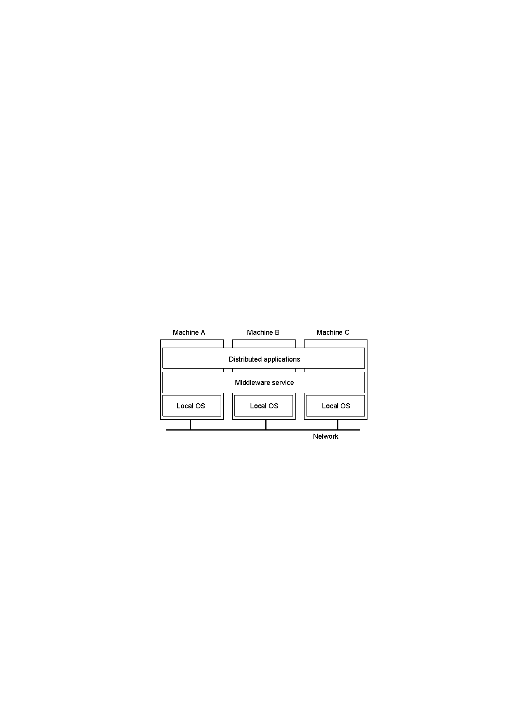
Distributed System

Slide 8
Factors that led to the emergence of distributed computing system:
Inherently distributed applications
  Organizations once based in a particular location have gone global.
Information sharing among distributed users
  CSCW:
Resource sharing
  Such as software libraries, databases, and hardware resources.

Slide 9
Factors that led to the emergence of distributed computing system:
Better price-performance ratio
Shorter response times and higher throughput
Higher reliability
  Reliability refers to the degree of tolerance against errors and component failures in a system.
  Achieved by multiplicity of resources.

Slide 10
Factors that led to the emergence of distributed computing system:
Extensibility and incremental growth
  By adding additional resources to the system as and when the need arise.
  These are termed as open distributed System.
Better flexibility in meeting user’s needs

Slide 11
Distributed Operating system
OS controls the resources of a computer system and provides its users with an interface or virtual machine that is more convenient to use than the bare machine.
Primary tasks of an operating system:
  To present users with a virtual machine that is easier to program than the underlying hardware.
  To manage the various resources of the system.
Types of operating systems used for distributed computing systems:
  Network operating systems
  Distributed operating systems.

Slide 12
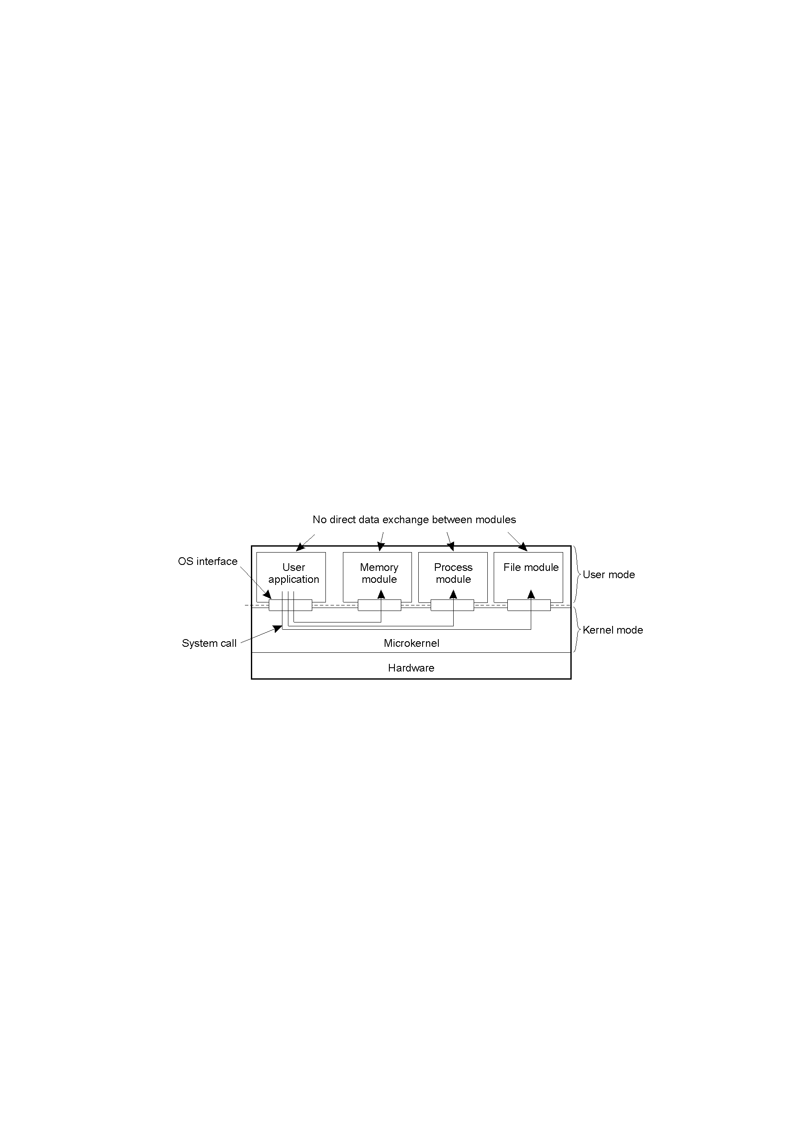
Uniprocessor Operating Systems
Separating applications from operating system code through a microkernel

Slide 13
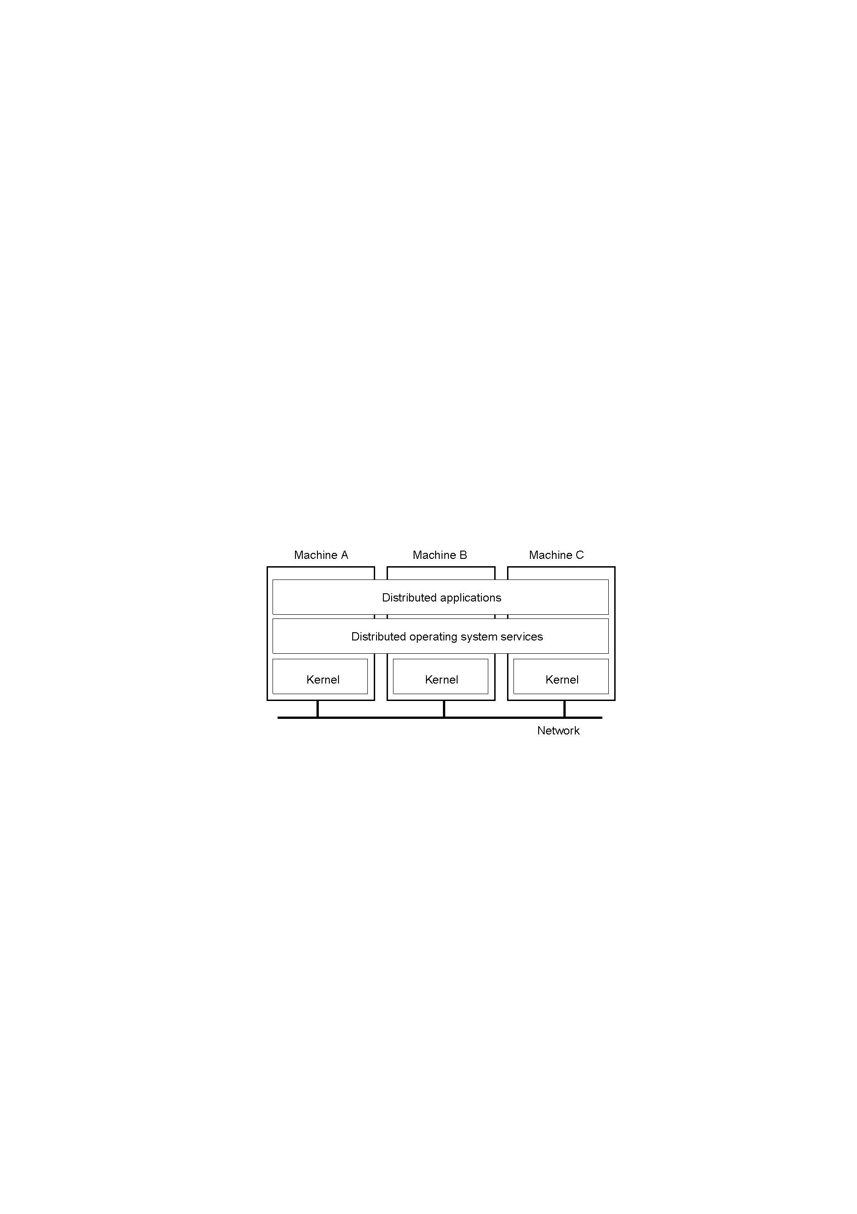
Multicomputer Operating Systems

Slide 14
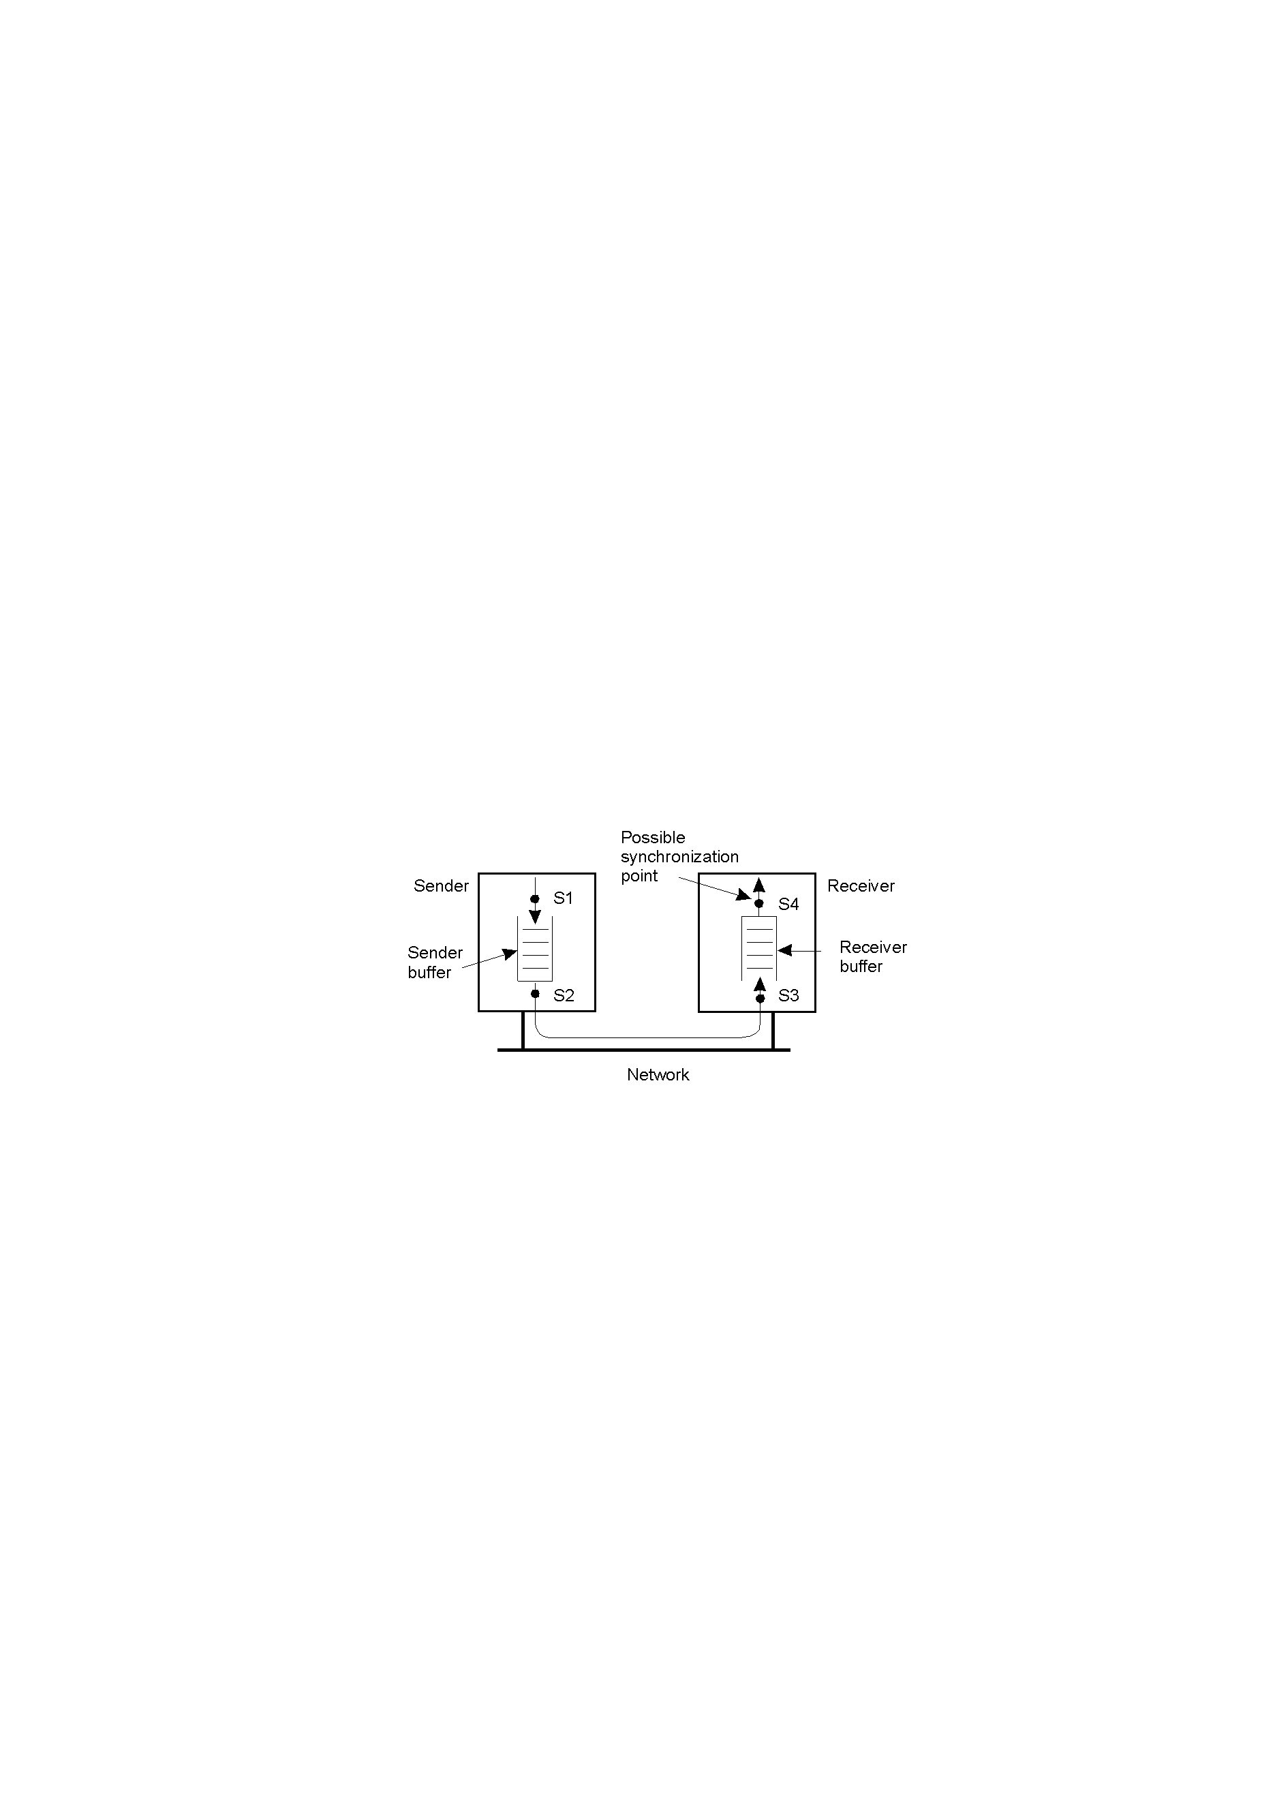
Message Transfer

Slide 15
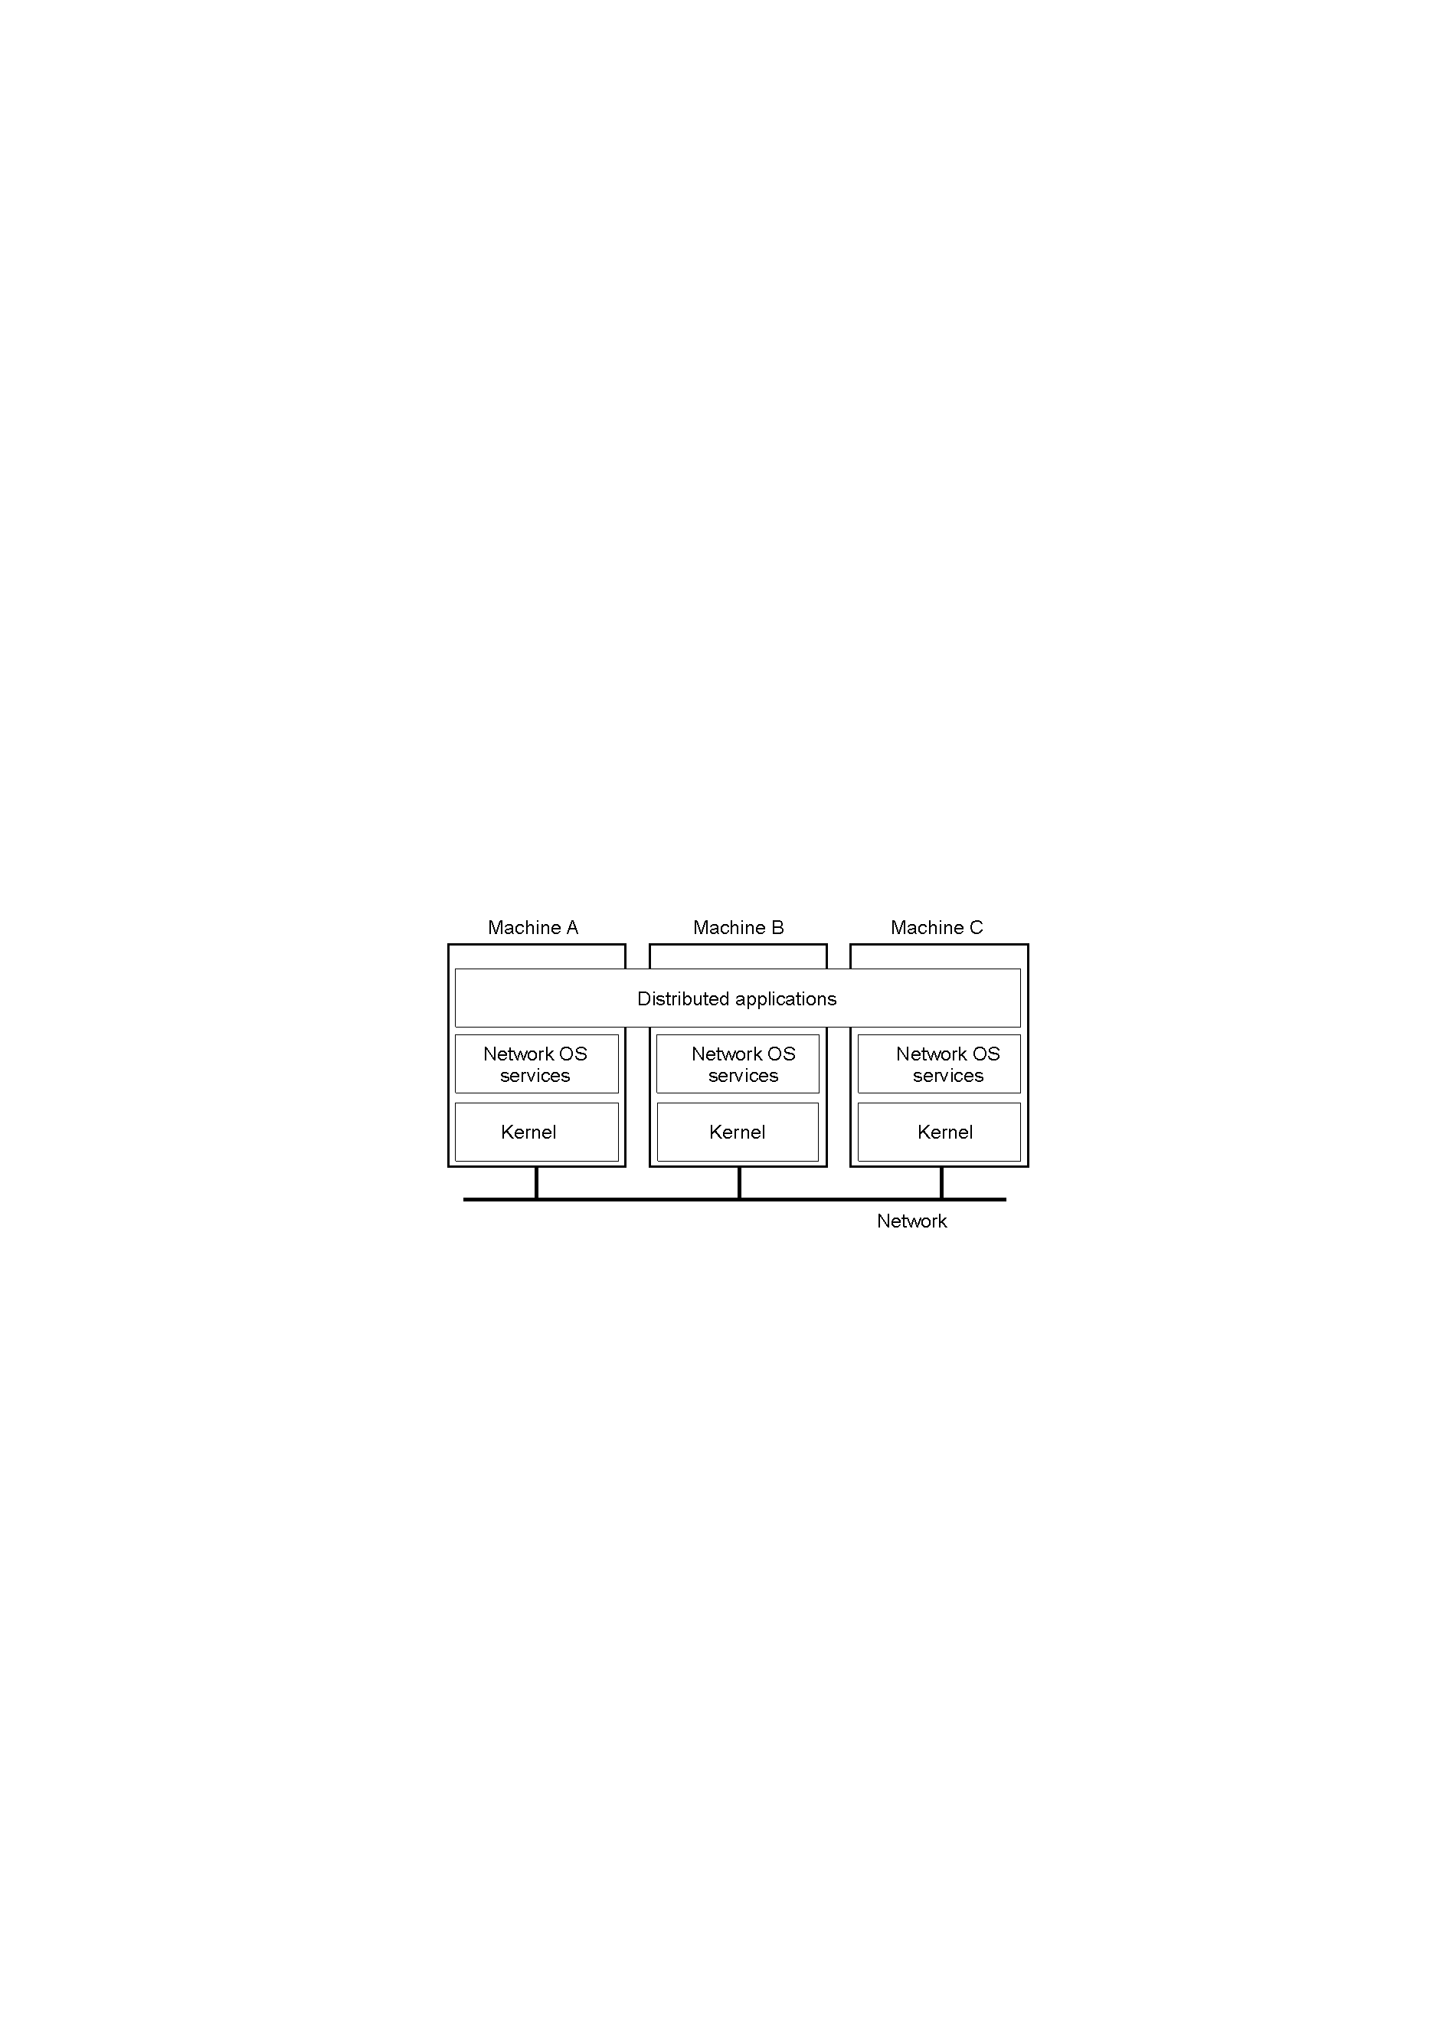
Network Operating System

Slide 16
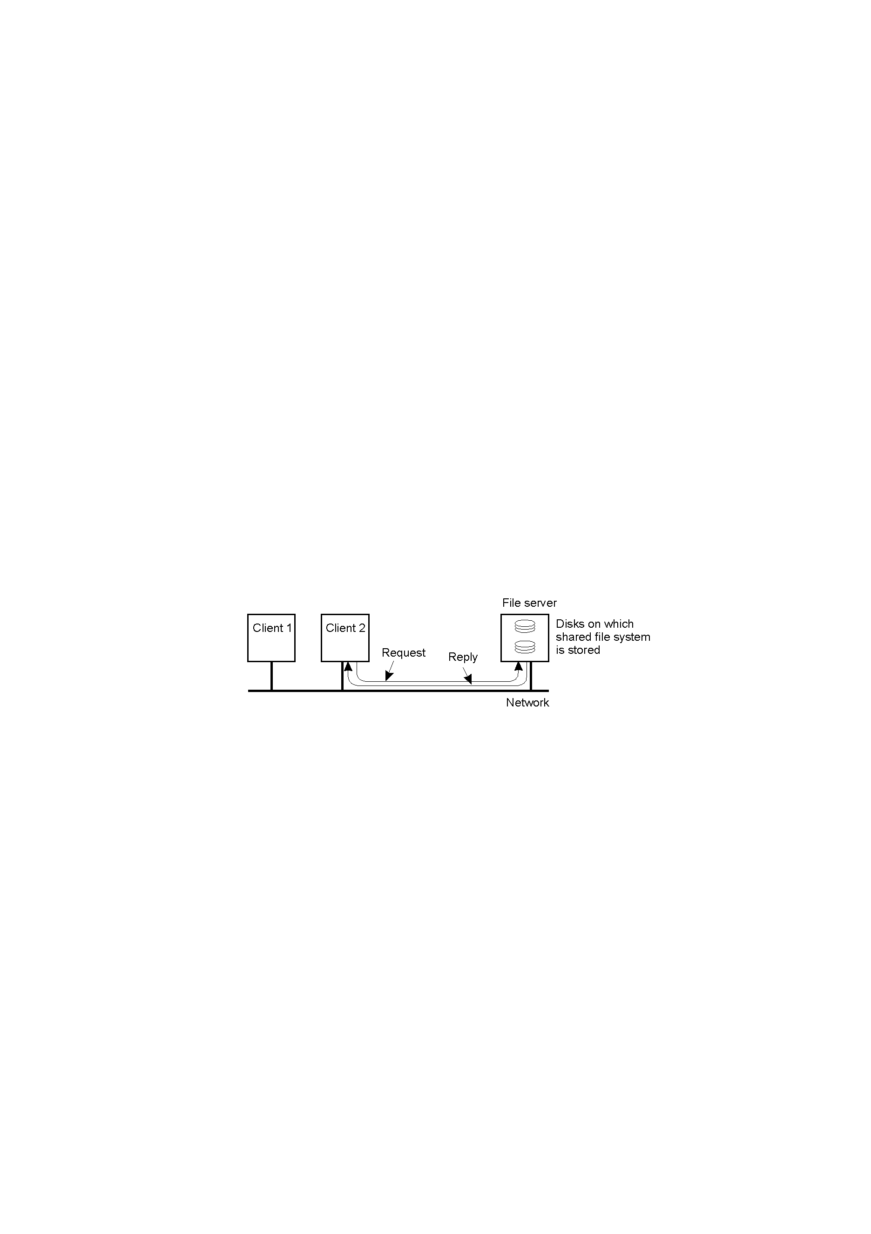
Network Operating System

Slide 17

Distributed System as Middleware

Slide 18

Middleware and Openness
In an open middleware-based distributed system, the protocols used by each middleware layer should be the same, as well as the interfaces they offer to applications

Slide 19
Major Differences
System image
  In NOS, user perceives the DCS as a group of nodes connected by a communication N/W. Hence, user is aware of multiple computers.
  DOS hides the existence of multiple computers and provides a single system image to its users. Hence group of Networked nodes act as virtual Uniprocessor.
  In NOS, by default user’s job is executed on the machine on which the user is currently logged on, else he has to remote login.
  DOS dynamically allocates jobs to the various machines of the system for processing.

Slide 20
Cont…
2. AUTONOMY
  Different nodes in NOS may use different O.S. but communicate with each other by using a mutually agreed on communication protocol.
  In DOS, there exists single system wide O.S. and each node of the DCS runs a part of OS (i.e. identical kernels run on all the nodes of DCS).
This ensures same set of system calls globally valid.
3. FAULT TOLERANCE
  Low in Network OS
  High in Distribute OS
DCS using NOS generally referred as N/W System
DCS using DOS generally referred as Distributed System

Slide 21
Issues :
Transparency
Reliability
Flexibility
Performance
Scalability
Heterogeneity
Security
Emulation to existing operating systems

Slide 22
TRANSPARENCY
  To make the existence of multiple computers transparent &
  Provide a single system image to its users.
ISO 1992 identifies eight types of transparencies:
  Access Transparency
  Location Transparency
  Replication Transparency
  Failure Transparency
  Migration Transparency
  Concurrency Transparency
  Performance Transparency
  Scaling Transparency

Slide 23
Access Transparency
Allows users to access remote resources in the same way as local i.e. user interface which is in the form of a set of system calls should not distinguish between local and remote resources.

Slide 24
Location transparency
Aspects of location transparency
  Name Transparency
    Name of a resource should not reveal any information about physical location of resource.
    Even movable resources such as files must be allowed to move without having their name changed.
  User Mobility
    No matter which machine a user is logged onto, he should be able to access a resource with the same name.

Slide 25
Replication Transparency
Replicas are used for better performance and reliability.
Replicated resource and the replication activity should be transparent to user.
Two important issues related to replication transparency are:
  Naming of Replicas
  Replication Control
There should be a method to map a user-supplied name of the resource to an appropriate replica of the resource.

Slide 26
Failure Transparency
In partial failures, system continues to function may be with degraded transparency.
Complete failure transparency is not achievable.
Failure of the communication network of a distributed system normally disrupts the work of its users and is noticeable by the users.

Slide 27
Migration Transparency
Migration may be done for performance, reliability and security reasons.
The aim of migration transparency is
  To ensure that the movement of the object is handled automatically by the system in a user-transparent manner.
Issues for migration transparency:
  Migration decisions
  Migration of a process

Slide 28
Concurrency transparency
Virtualization that:
  One is sole user of the system &
  Other users do not exist in the system.
Properties for providing concurrency transparency:
  Event Ordering Property
    It ensures that all access requests to various system resources are properly ordered to provide a consistent view to all users of the system.
  Mutual Exclusion property
    At any time at most one process accesses a shared resource & not used simultaneously.

Slide 29
Cont…
  No starvation policy
    It ensures that if every process that is granted a resource, which must not be used simultaneously by multiple processes, eventually releases it, every request for that resource is eventually granted.
  No deadlock
    It ensures that a situation will never occur in which competing processes prevent their mutual progress even though no single one requests more resources than available in the system.

Slide 30
Performance transparency
  The aim of performance transparency is to allow the system to be automatically reconfigured to improve performance, as loads vary dynamically in the system.
  A situation in which one processor of the system is overloaded with jobs while another processor is idle should not be allowed to occur.

Slide 31
Scaling transparency
It allows the system to expand in scale without disrupting the activities of the users.
It requires open system architecture and use of scalable algorithms.

Slide 32
RELIABILITY
The distributed systems are required to be more reliable than centralized systems due to
  The multiple instances of resources.
Failure should be avoided & their types are:
  Fail stop Failure: System stops functioning after changing to a state in which its failure can be detected.
  Byzantine Failure: System continues to function but produces wrong results.

Slide 33
Cont…
Methods to handle failure in distributed system :
  Fault Avoidance
  Fault Tolerance
  Fault Detection
  Fault detection and recovery

Slide 34
Fault Avoidance
It Deals with designing the components of the system in such a way that the occurrence of faults is minimized.
For this, reliable hardware components and intensive software test are used.

Slide 35
Fault Tolerance
It is the ability of a system to continue functioning in the event of partial system failure.
Method for tolerating the faults:
  Redundancy techniques
    Avoid single point of failure by replicating critical hardware and software components,
    Additional overhead is needed to maintain multiple copies of replicated resource & consistency issue.
  Distributed control
    A highly available distributed file system should have multiple and independent file servers controlling multiple and independent storage device.

Slide 36
Fault detection and recovery
Some Techniques :
Atomic Transaction
Use of stateless servers
  History of the serviced requests between Client and Server affects the execution of rest service request.
Acknowledgements and timeout-based retransmissions of messages
  For IPC between two processes must have ways to detect lost messages so that they could be retransmitted.

Slide 37
FLEXIBILITY
The design of a distributed operating system should be flexible due to:
  Ease of Modification
  Ease of Enhancement
Kernel is the most important influencing design factor which operates in a separate address space that is inaccessible to user processes.
Commonly used models for kernel design in distributed operating systems :
  Microkernel model
  Monolithic model

Slide 38
Monolithic kernel model
Most operating system services such as process management, memory management, device management , file management, name management, and inter-process communication are provided by the kernel.
Result : the kernel has a large monolithic structure.
The large size of the kernel reduces the overall flexibility and configurability of the resulting operating system.
A request may be serviced faster.
  No message passing and no context switching are required while the kernel is performing the job.

Slide 39
Cont…
Node 1
Node 2
Node n
user applications
Monolithic kernel (includes most OS services)
user applications
Monolithic kernel (includes most OS services)
user applications
Monolithic kernel (includes most OS services)
Network Hardware

Slide 40
Microkernel model
Goal is to keep the kernel as small as possible.
Kernel provides only the minimal facilities necessary for implementing additional operating system services like:
  inter-process communication,
  low-level device management, &
  some memory management.
All other OS services are implemented as user-level server processes. So it is easy to modify the design or add new services.
Each server has its own address space and can be programmed separately.

Slide 41
Cont…
Node 1
Node 2
Node n
user applications
Server/manager modules
Microkernel (has only minimal facilities)
user applications
Server/manager modules
Microkernel (has only minimal facilities)
user applications
Server/manager modules
Microkernel (has only minimal facilities)
Network Hardware

Slide 42
Cont…
Modular in nature, OS is easy to design, implement and install.
For adding or changing a service, there is no need to stop the system and boot a new kernel, as in the case of monolithic kernel.
Performance penalty :
  Each server module has to its own address space. Hence some form of message based IPC is required while performing some job.
  Message passing between server processes and the microkernel requires context switches, resulting in additional performance overhead.

Slide 43
Cont…
Advantages of microkernel model over monolithic kernel model:
  Flexibility to design, maintenance and portability.
  In practice the performance penalty is not too much due to other factors and the small overhead involved in exchanging messages which is usually negligible.

Slide 44
PERFORMANCE
Design principles for better performance are:
Batch if possible
  Transfer of data in large chunk is more efficient than individual pages.
Caching whenever possible
  Saves a large amount of time and network bandwidth.
Minimize copying of data
  While a message is transferred from sender to receiver, it takes the following path:
    From senders stack to its message buffer
    From message buffer in senders address apace to message buffer in kernels address space

Slide 45
Cont…
    Finally from kernel to NIC
  Similarly on receipt ,hence six copy operations are required.
Minimize Network traffic
  Migrate process closer to resource.
Take advantage of fine-grain parallelism for multiprocessing
  Use of threads for structuring server processes.
  Fine-grained concurrency control of simultaneous accesses by multiple processes to a shared resource for better performance.

Slide 46
SCALABILITY
Scalability refers to the capability of a system to adapt to increased service load.
Some principles for designing the scalable distributed systems are
  Avoid centralized entities
    Central file server
    Centralized database
  Avoid centralized algorithms
  Perform most operations on client workstation

Slide 47
Heterogeneity
Dissimilar hardware or software systems.
Some incompatibilities in a heterogeneous distributed system are:
  Internal formatting schemes
  Communication protocols and topologies of different networks
  Different servers at different nodes
Some form of data translation is necessary for interaction.
An intermediate standard data format can be used.

Slide 48
Security
Security in distributed system is more difficult than in a centralized system because of
  The lack of a single point of control &
  The use of insecure networks for data communication.
Requirements for security
  It should be possible for the sender of a message to know that the message was received by the intended receiver.
  It should be possible for the receiver of a message to know that the message was sent by the genuine receiver.

Slide 49
Cont…
  It should be possible for both the sender and receiver of a message to be guaranteed that the contents of the message were not changed while it was in transfer.
Cryptography is the solution.

